Slide 1


ČMZRB – Czech Development Bank
EIB Group & ČMZRB Group
Video Conference | 07.09.2020

Slide 2
Contents
1
ČMZRB’s Role
2
Financial Instruments
3
National Development Fund
EIB Group & ČMZRB Group
Video Conference | 07.09.2020

Slide 3
The mission of ČMZRB is to support implementation of the state's economic policy objectives
Strategy
Approach
Products
  Bank's focus has expanded from the traditional SME segment to other sectors:
    Infrastructure
    Energy
    Digitital economy
    Social enterprises
    Etc.
  The product portfolio is prepared in line with:
    Government priorities
    Market needs
    Financial resources
  Product range includes:
    Loans
    Guarantees
    Mezzanine finance
    Technical assistance (Advisory)
EIB Group & ČMZRB Group
Video Conference | 07.09.2020

Slide 4
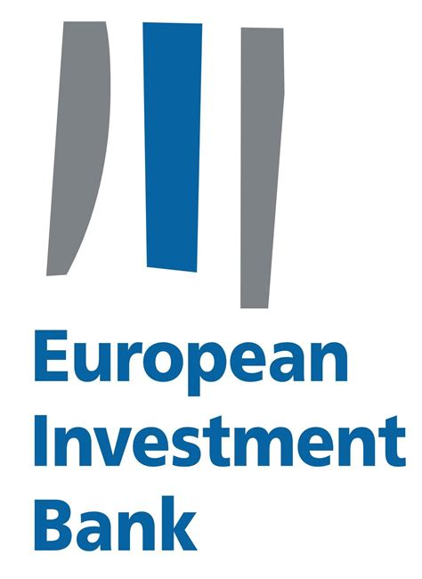


ČMZRB's vision is to become a „local" EIB and a strong national development bank
EIB Group & ČMZRB Group
Video Conference | 07.09.2020

Slide 5
The objective of ČMZRB is to help development of the national economy
Enable projects
Reduce their costs
Facilitate multi-source financing
  Enabling the implementation of projects that are in line with the priorities of the state's economic policy, but without the support of ČMZRB would be difficult to implement.
  Reducing costs of projects by providing financial instruments that decrease final costs of financing for their implementers.
  Mobilization of non-budgetary sources of financing (especially corporate investments for the development of public infrastructure and services),
  ie. reducing budgetary requierements.
EIB Group & ČMZRB Group
Video Conference | 07.09.2020

Slide 6
Obsah
1
ČMZRB’s Role
2
Financial Instruments
3
National Development Fund
EIB Group & ČMZRB Group
Video Conference | 07.09.2020

Slide 7
ČMZRB provides 3 basic financial instruments plus technical assistance (1)
Loans
Guarantees
(Quasi) equity investments
  Discounted or interest-free loans (limited to a set percentage of the total investment).
  Guarantees for selected types of risks of investment projects:
    risks of the contracting authority,
    supplier risks,
    financing risks,
    implementation risks.
  Capital investments and mezzanine financing through the NRF
EIB Group & ČMZRB Group
Video Conference | 07.09.2020

Slide 8
ČMZRB provides 3 basic financial instruments plus technical assistance (2)
  „Technical assistance" contains consulting support for project sponsors inrelation with: selection of suitable projects, the process of their preparation, and ensuring financial feasibility.
EPC
Smart City
PPP
Project Finance
EIB Group & ČMZRB Group
Video Conference | 07.09.2020

Slide 9
Obsah
1
ČMZRB’s Role
2
Financial Instruments
3
National Development Fund
EIB Group & ČMZRB Group
Video Conference | 07.09.2020

Slide 10

NRF’s objective is to involve private resources in building public infrastructure
National Development Fund (NRF) is a subsidiary of the Czech-Moravian Guarantee and Development Bank financed from the resources of commercial banks.
Thanks to its construction, it is able to mobilize also other private resources.
It provides riskier forms of project financing, especially in the area of infrastructure.
EIB Group & ČMZRB Group
Video Conference | 07.09.2020

Slide 11




The main financial instrument of the NRF is mezzanine financing of infrastructure projects
Transport
Healthcare
Education
Justice
Motorways
High speed railways
Airports and terminals
Hospitals
Senior Housing
Universities
Student dormitories
Justice courts
Prisons
EIB Group & ČMZRB Group
Video Conference | 07.09.2020

Slide 12
Thank you!
Českomoravská záruční a rozvojová banka, a.s.
Jeruzalémská 964/4
110 00 Praha 1
Czechia
www: www.cmzrb.cz
E-mail: info@cmzrb.cz
EIB Group & ČMZRB Group
Video Conference | 07.09.2020

